Slide 1

TEAM PANDEMONIUM
JACK GOBLE
THAI DO
ZUBE MOLOKWU
LEVI SHIRLEY

Slide 2
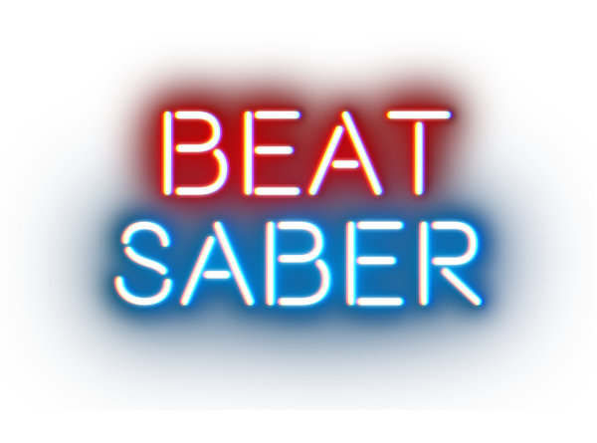


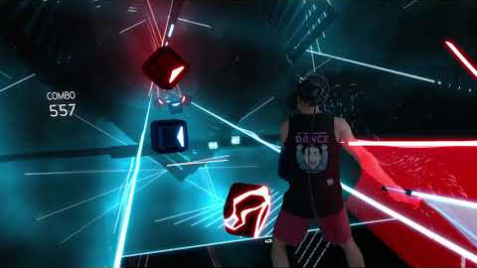
Beat Saber is a virtual reality rhythm game.
The goal of the players is to slash the incoming notes, avoid slashing bombs, and dodge walls.
When you slash a note, you have to slash it with the saber of the same color, and the direction of the slash has to be in the direction that the note specifies.

Slide 3

Beat-Maps
A beat-map is the level for a song that a player can play
A beat-map can have different difficulties: Easy, Normal, Hard, Expert, Expert+
Anyone can make a beat-map for any song, and share that beat-map with other players
A beat-map is a 3x4 grid, so a note, bomb, or wall can be placed within any of these 12 spots at any moment in time.

Slide 4

Goal of the Project
Because anyone can make a beat-map, there is an inconsistency among the shared maps
Some maps that are shared online are impossible to play
Because of this, we wanted to build a neural network that is capable of automatically generating beat-maps given a song

Slide 5

Audio File Processing
We used the Librosa library which allowed us to do the following:
Load the audio file (.ogg file)
Find the duration of the file in seconds
Resample the song and determine the tempo
After resampling the song to a specific number of samples per beat, the audio file is divided into 1/8th notes
We perform a Fourier Transformation on each of these notes which breaks down the audio into simpler constituent frequencies

Slide 6

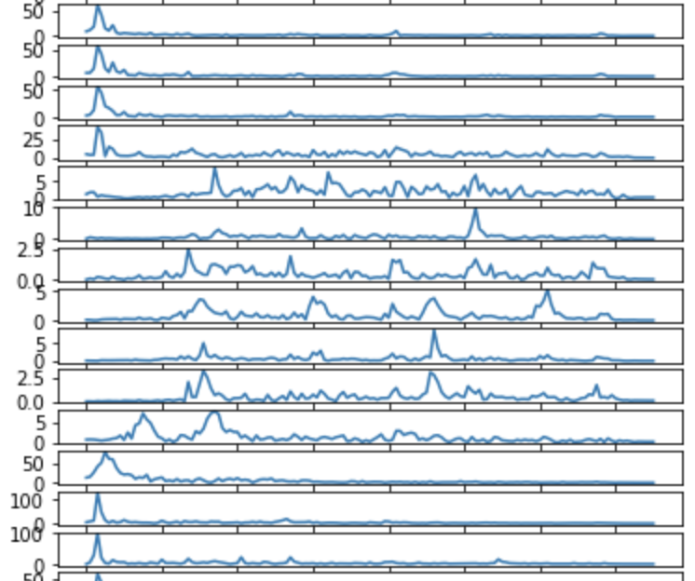
Principle Component Analysis
Data separated into 150 frequency bands at each time-step.
Goal is to isolate which frequencies provide the greatest indication that something “important” is happening
FFT data over time

Slide 7
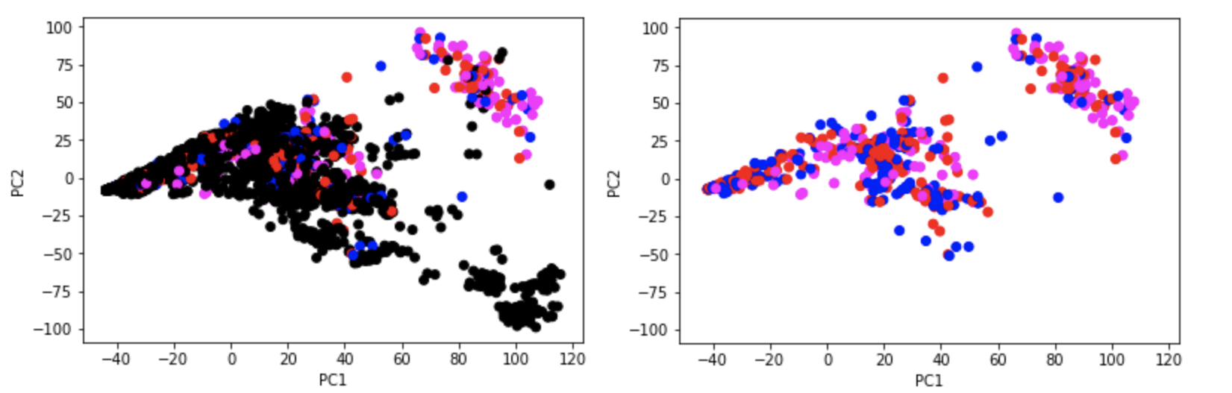
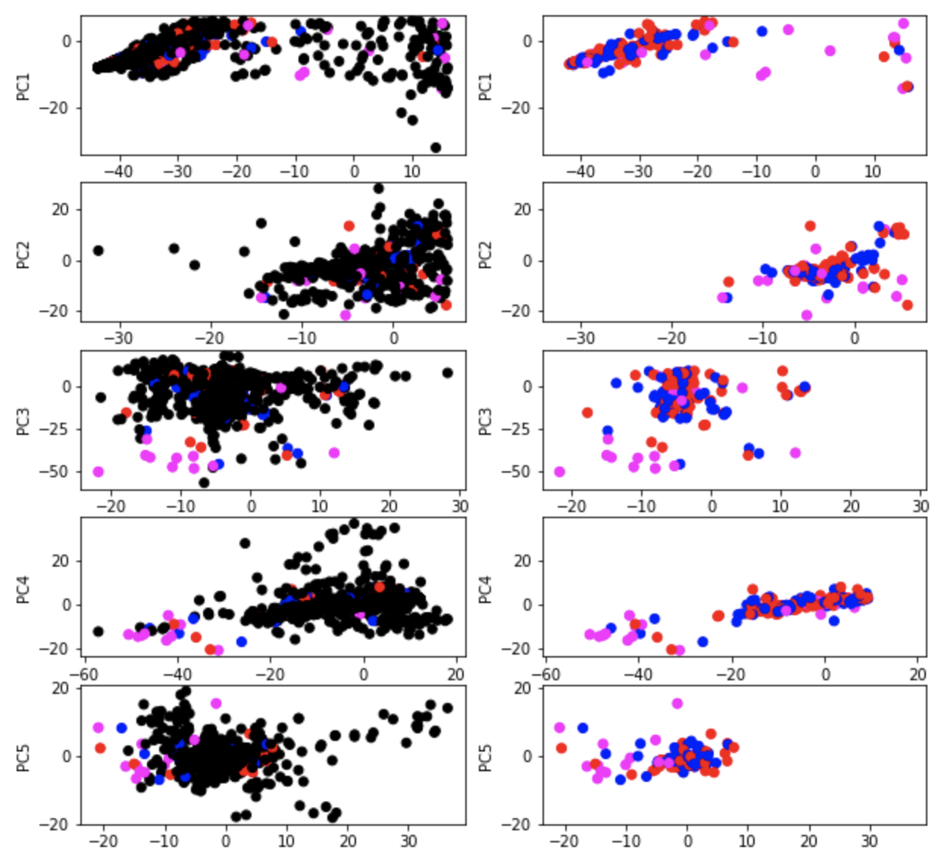
P.C.A. (part 2)
Due to the nature of the data, there is about a 4:1 ratio of “No-note” vs anything else.
The first principle component separated several points
Subsequent components each only provided a few outliers
We kept all 150 components

Slide 8
FIRST NETWORK

Slide 9

Convolution Layer
This layer takes in the input data, and performs a convolution on it giving us access to a larger time interval
The activation function we used is the Rectified Linear Unit (RELU) function.
The output of this layer will go into an LSTM layer.

Slide 10

LSTM Layer
This layer looks at each particular piece of the song while keeping in mind the previous piece and the upcoming piece in order to update the weights appropriately
This layer generates two outputs : One for direction and the other for the color of the note
These two outputs are then fed into two separate dense layers
Information is passed to a deconvolution layer

Slide 11
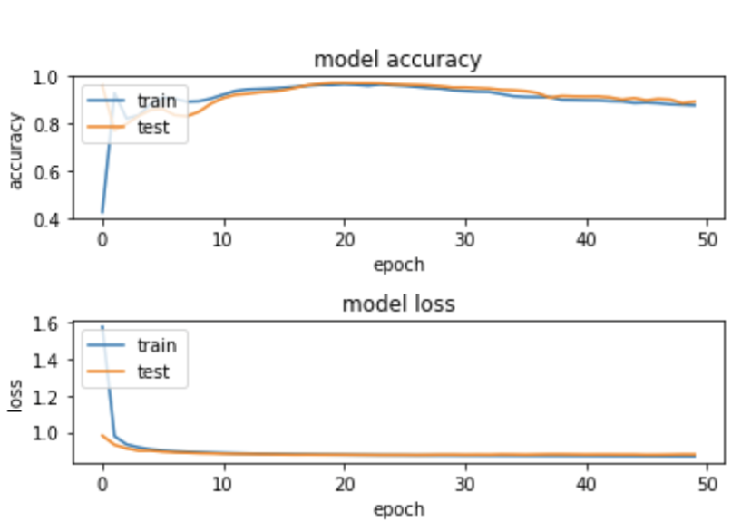
TRAINING AND TESTING
AVERAGE TRAINING ACCURACY – 88%
AVERAGE TESTING ACCURACY – 92%

Slide 12
Revised NETWORK

Slide 13
Revised Network
The previous network wasn’t generalizing well enough.
So, we made the following changes:
Branched earlier (Right after LSTM layer)
Used a linear activation function for the dense layers
Reshaped the dense layers
Performed a softmax
Removed the concatenation layer
This yielded a model with one input and two outputs
Both outputs were softmax
This allowed us to use two loss functions
And minimize the loss for both color and direction

Slide 14
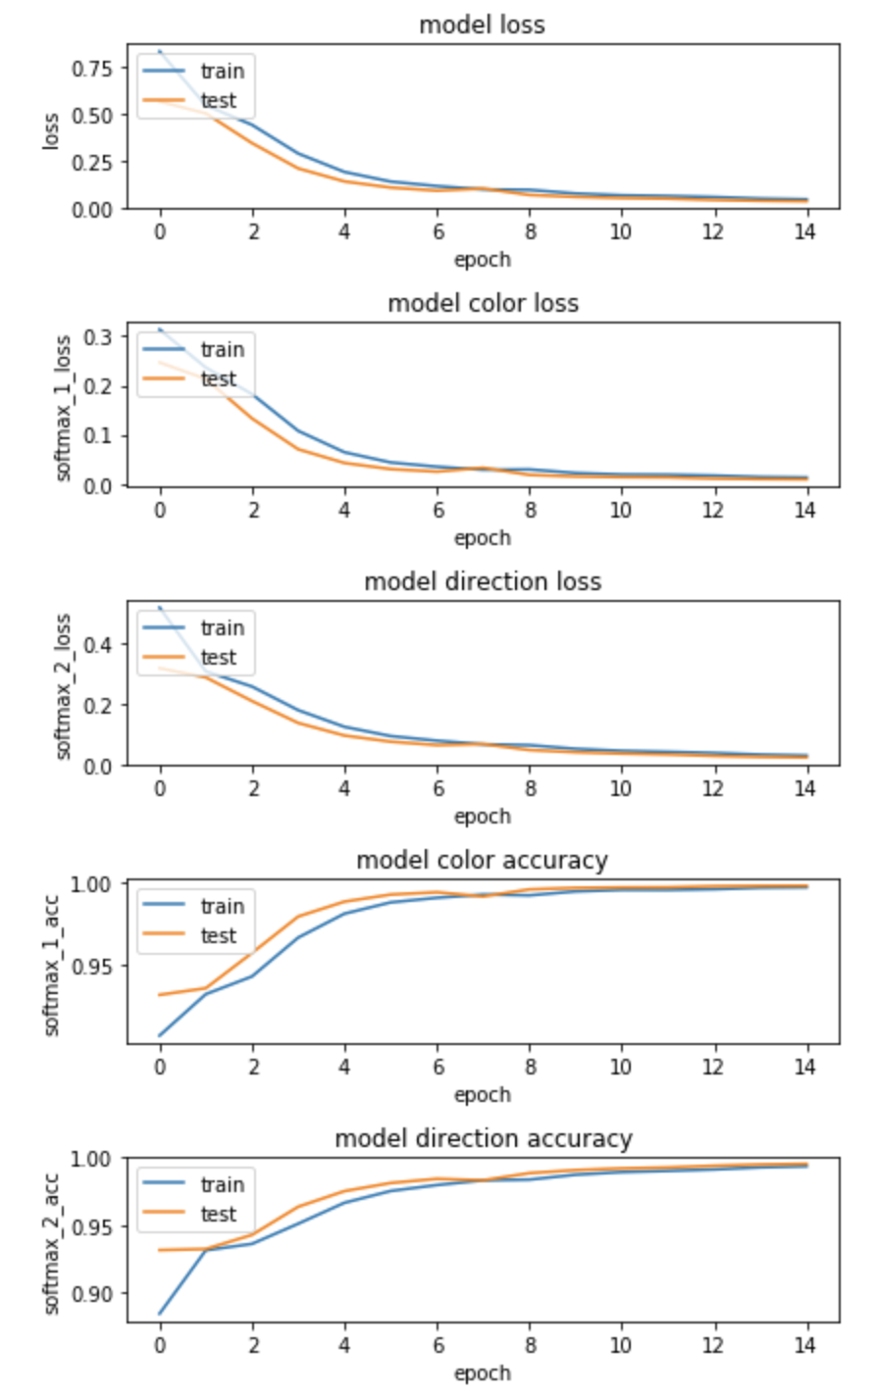
TRAINING AND TESTING
Shows evidence of training
Uses a batch size schedule
Train and test have shared information

